Slide 1


CONSULTING
EXPERIENCE
PROJECT
Task-1
Company and Industry Analysis
Jio Mart

Slide 2
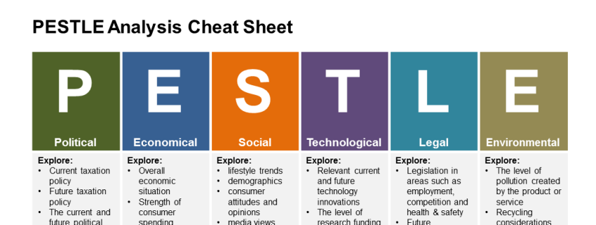
Political
Strong democracy with a strong government.
Despite efforts towards globalization, India still experiences some degree of protectionism, which is good for a home player to grow like Jio Mart.
Announcement of various initiatives like Digital India, promoting cashless economy will help Jio Mart to grow.
RBI allowed interoperability among prepaid payment instruments such as digital wallets, prepaid cash coupons, etc. greatly access customers by giving discounts.
Economic
The relativistic stability in the agricultural market throughout the nation, due to increased production.
High rise of trading activities in the stock markets since the pandemic, increase the market value potential.
Through recent times due to nationwide restrictions and unsteady employment, the focus on essential consumable products and its non-contact delivery has increased, hence O2O markets such as Jio Mart can improve its business further.

Slide 3
Social
Demographics in terms of population, growth, and urbanization present a very favorable market.
An increase in women's employment directly affects the growth of the E grocery market.
With very little time to spend with family, convenient and free home delivery became a key factor.
Security and Privacy while doing transactions remain a significant impediment for growth.
Technological
With the rising surge of onlinel purchase activity throughout the nation, Jio Mart can increase digital advertising and introduce seasonal offers over range of products.
Improving the application user interface, secure payments, efficient customer support and faster delivery options can greatly influence buy experience of the customers.
The rising population of skilled IT professionals provides more possibilities of employing high potential proletariat who can analyse and improvise the market platform.

Slide 4
LEGAL
ENVIRONMENT
The government working on the possibility to set up a regulatory authority to resolve disputes between large online retailers and small enterprises in the country will help in smoothing the vendor ecosystem in the company
Government new policy imposing ban on e-commerce firms from influencing pricing, employing unfair promotional activities, as well as misrepresenting the quality or features of their product offering may affect the continuous growth of the company
E-commerce players will also be compelled to store generated data on servers in India. This would put an additional burden on the firm
Investing on high efficiency equipments and cleaner energy sources in the transport and distribution sector highly reduces fuel consumption and energy usage.
Facilitating an online platform for transactions of daily essential products decreases the usage of transport modes for daily commuting to local markets which collectively throughout nation reduces emission rates annually.
Removing the need of having physical retail centres on regional basis, will avoid over usage of infrastructure and land resources.

Slide 5
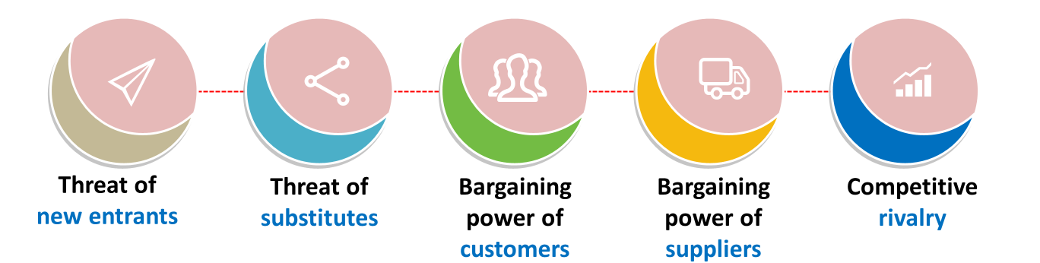
High
Medium
Low
-- Reduced rates of certain consumable products at specific regions can negatively influence sales of that product through the online platform.
-- Recent pandemic has given a window for newer e-commerce firms to expand their businesses.
Very High
-- Availability of larger number of suppliers across the country has reduced the negotiative power of suppliers.
--Abundance of raw materials for the consumable products increase competition in production which decreases freedom in price setting.
-- Going through the red ocean strategy, lot of changes and development in product marketing methods is constantly required.
-- Factors like product quality and delivery rates set the difference due to which competitors gain customer trust.
High
-- Capital requirement is less for the hyperlocal model.
-- Barriers of entry is less for E- Grocery store.
-- Established companies(Future Group, Big Basket, Gofers, etc) can easily take over the market share.
--With the technology growth, more people have access to internet and smartphones.
--In accordance with better discounts and offers, customers can switch between different online stores or offline stores.

Slide 6
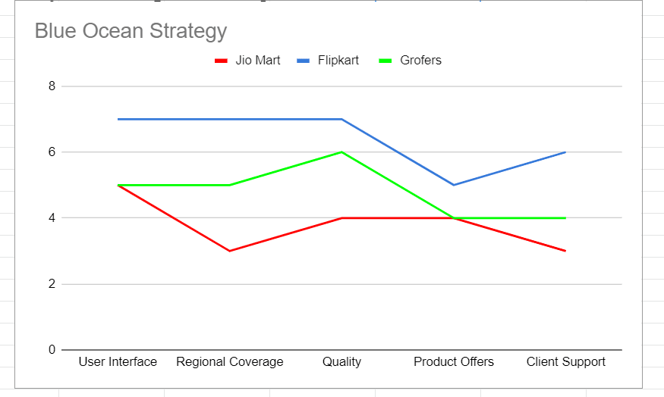

Slide 7
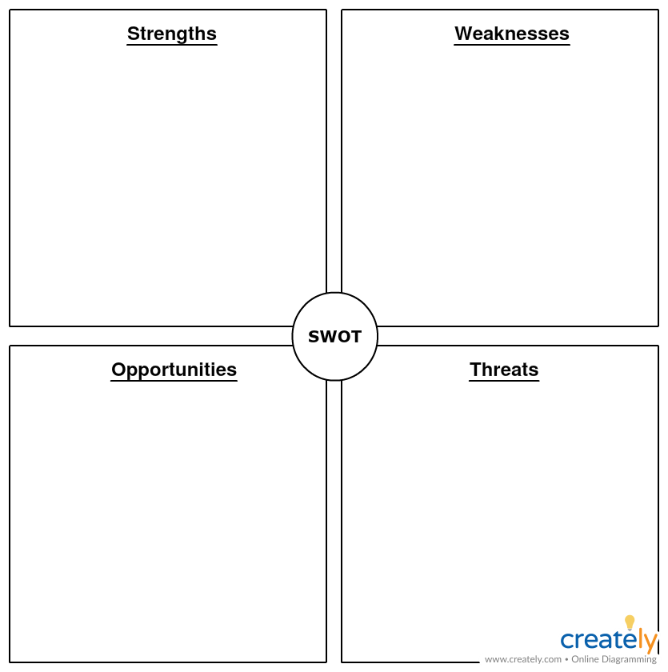
Aggregates millions of small merchants to form a pan-India supply chain through WhatsApp messenger integration with Jio
Low-cost procurement (bulk buying)
Global investments from big players like Facebook and Google .
Consumer centric and friendly business model: No questions asked return policy, no minimum order policy, big discounts etc.
Product life is short due to which quality varies depending upon deliver rate and region of source of product.
Limited to accessible regions across the nation, and prone to bigger competitions with better reach.
Lesser payment options and interrupted transactions due to technical hitches.
Increase network and collaboration with small scale retailers creating better range of products.
Consumable product retails has large transactions at a huge scale.
Having a reputed brand value over other services from Reliance, Jio Mart can instill trust and reliability among its customers through better service.
The industry still presents enticing entry opportunities, especially the ecommerce giants out there.
Low Trust margin, buffer of error will be minimum, since consumers have ample of options to shift to.
Niche-focussed e-commerce players with custom models for specific product categories (dairy, produce)

